Slide 1

Design Of Social Robo
CSE 564: Software Design
TEAM 4

Slide 2
Design Phases
3D Printing

Slide 3
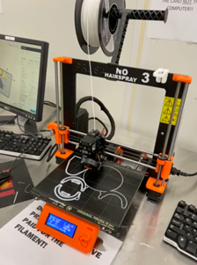
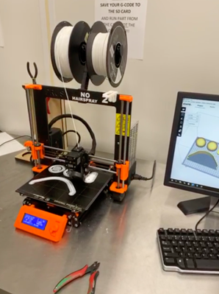
PHASE-1
Printing the robot parts
The first part of this phase began with printing robot eyes using Prusa i3 MK2 printer
The further printing of parts continued in the same way. Below is the picture of robot lips being printed using same printer
Fig1: 3D Printing of eyes
Fig2: 3D Printing of lips

Slide 4
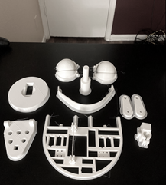
All Parts of the robot printed using Prusa i3 MK2 3-D printer
Fig3: All robot parts - eyes, nose, lips, base, head etc.

Slide 5
Design Phases
Parts Assembling

Slide 6
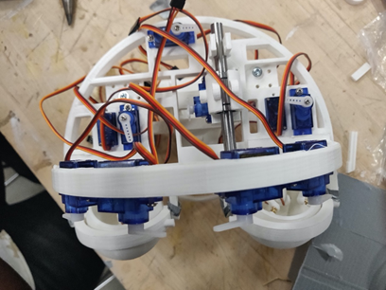
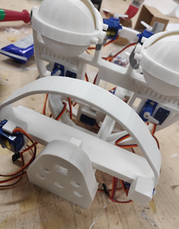
PHASE-II
Assembling THE ROBOT PARTS
1. Aggregation of the central part of the head integrating and fitting servos to the head and eyebrows of the robot
2. Picture showing assembly of the parts: Eyeballs, Neck Mount, Eye lids Upper jaw, and H-bridge. This was done after integration of head
Fig4: Fitting servo motors
Fig5: Assembling eyeballs, eye lids, neck, jaw and H-bridge

Slide 7
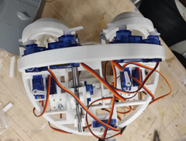
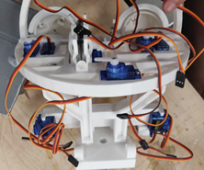
ASSEMBLING THE ROBOT PARTS
3. Top view of the robot head showing assembly of servo motors for controlling opening and closing of eyes and for control of the eyeball motion vertically
4. This is the front view of the assembled servo motors integrated for controlling the motion of the lips
Fig6: Top view to show for eye motion control
Fig7: Front view of servo integration for lip movement

Slide 8
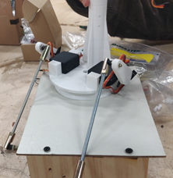
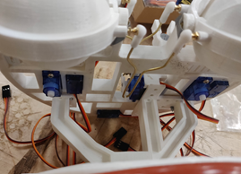
ASSEMBLING THE ROBOT PARTS
5. This shows the creation of robot base where 1501MG servos are mounted. The connection has been made from base to neck using threaded rods to control head movement
6. Connection of brass rods with servo arms to the robot eyelids and eyeballs to monitor control
Fig 8: Robot neck mounted on base
Fig 9: Brass rod connection with servo arms

Slide 9
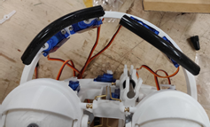
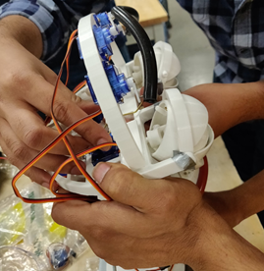
7. Connection for making robot eyebrows The eyebrow tubes have been connected to the servo arms using threaded screws (fig 11). Fig 10 shows front view of the connected robot eyebrows made using rubber tubes.
Fig 10: Front view of robot eyebrows
Fig 11: Rubber tube connection for robot eyebrows

Slide 10
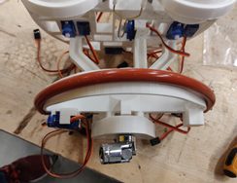
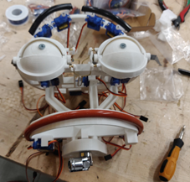
ASSEMBLING THE ROBOT PARTS
8. Connection of the Universal Joint with neck mount for providing the ability to move head in all required directions.
Also the figure shows the connection of upper lip made of brown pipe.
9. Attachement of the upperlip servos with the upper lip showing complete top view of the robot face with Universal Joint
Fig 12: Upper lip and Universal joint connection
Fig 13: Top view of robot face with lips and universal joint

Slide 11
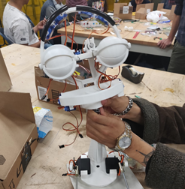
ASSEMBLING THE ROBOT PARTS
10. Connection of the robot head with the neck support to finish the robot modelling. The connection has been made using universal joint and upper robot neck which is mounted on the robot base platform. The robot is now complete.
Fig 14: Upper lip and Universal joint connection

Slide 12
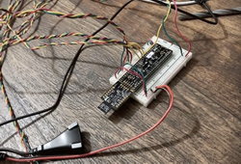
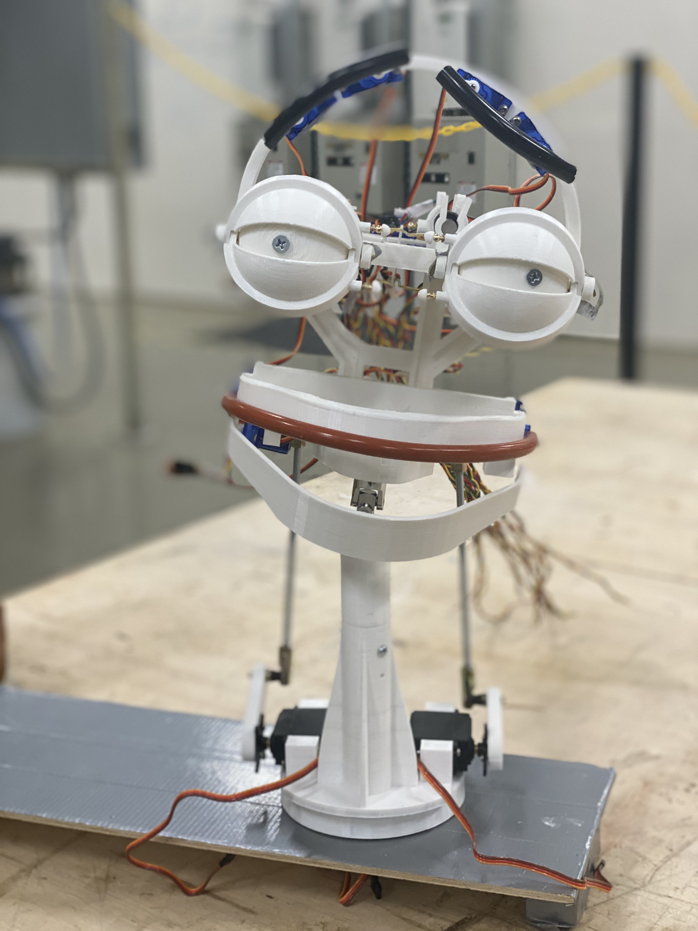
12. In Fig.16, the picture is showing the complete view of the completed robot mounted on the base
Fig 15: Connection to PSoC control board
11. In above Fig.15, the wires from the servos are connected to the PSoC control board which is used for programming the motion of robot's head, lips, eyes etc.
Fig 16: Completed robot mounted on base

Slide 13
Design Phases
Testing

Slide 14
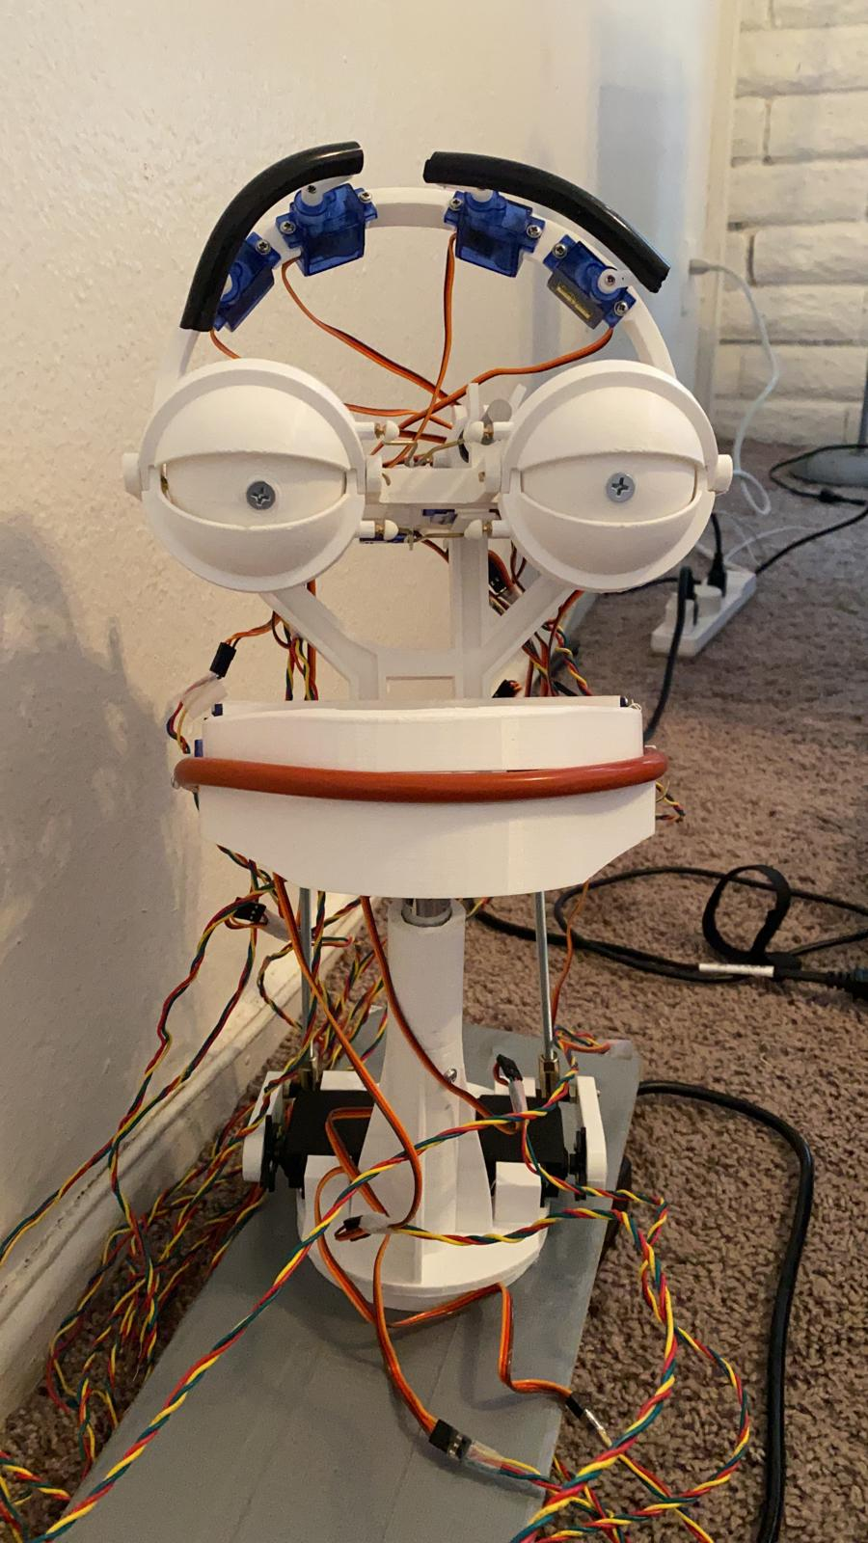
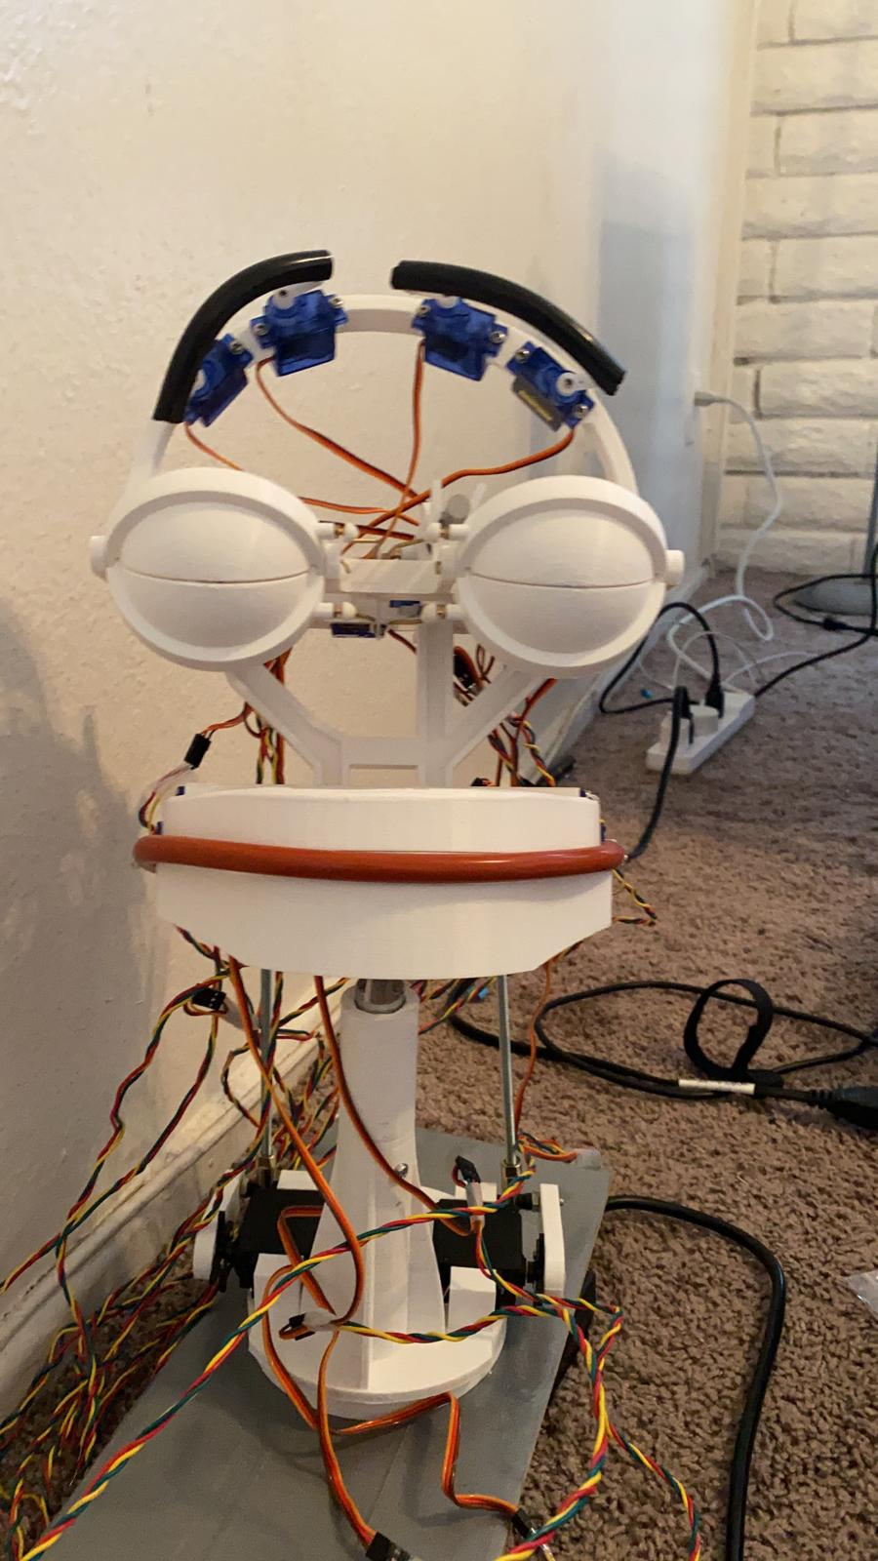
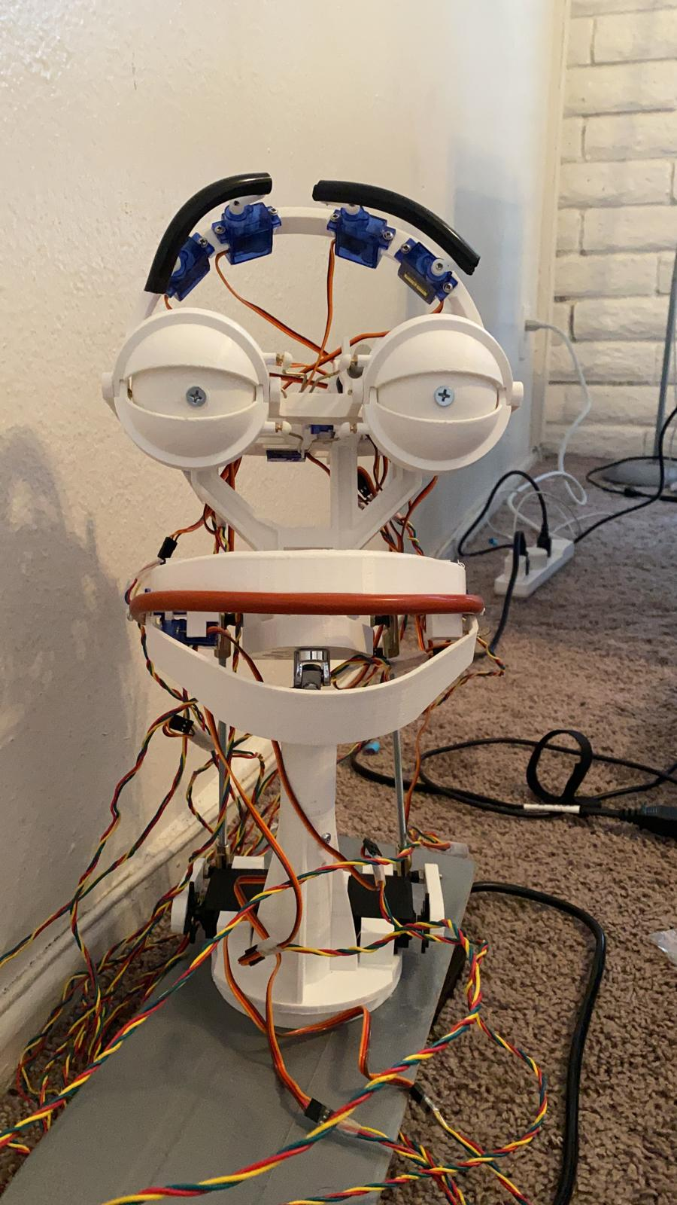
Phase iii: Testing the robot
Fig 17: Robot with open eyes
Fig 18: Robot with closed eyes
Fig 19: Robot with mouth open
The above pictures show the testing phase of robot where the completed robot can be seen demonstrating different expressions. Fig 17 shows the robot with raised eyebrows and open eyes while Fig18 shows closed eyes. The last Fig 19 shows the robot with mouth open.

Slide 15
Thank You

